Slide 1


Slide 2
meeting name
date

Slide 3
Presentation Title
Presenter Name

Slide 4
The transcriptional activity of Mycobacterium tuberculosis in vivo and its influence on treatment outcome
Eleanor lamont
Sherman lab uw

Slide 5
Title goes here
Item Number One
Item Number Two
Item Number Three
Sub-Item Number One
Sub-Item Number Two
Sub-Item Number Three

Slide 6
Title goes here
Item Number One
Item Number Two
Item Number Three
Sub-Item Number One
Sub-Item Number Two
Sub-Item Number Three

Slide 7
The transcriptional activity of Mtb in vivo and its influence on treatment outcome
Eleanor Lamont
Sherman Lab
TBRU 10/18/24
Notes:
I’m Ella, I’m a PhD student in the Sherman lab
And I want to tell you about a fairly new project we’ve been working on, examining the transcriptional activity of Mtb from patient sputa and thinking how we can find information related to treatment outcome.

Slide 8
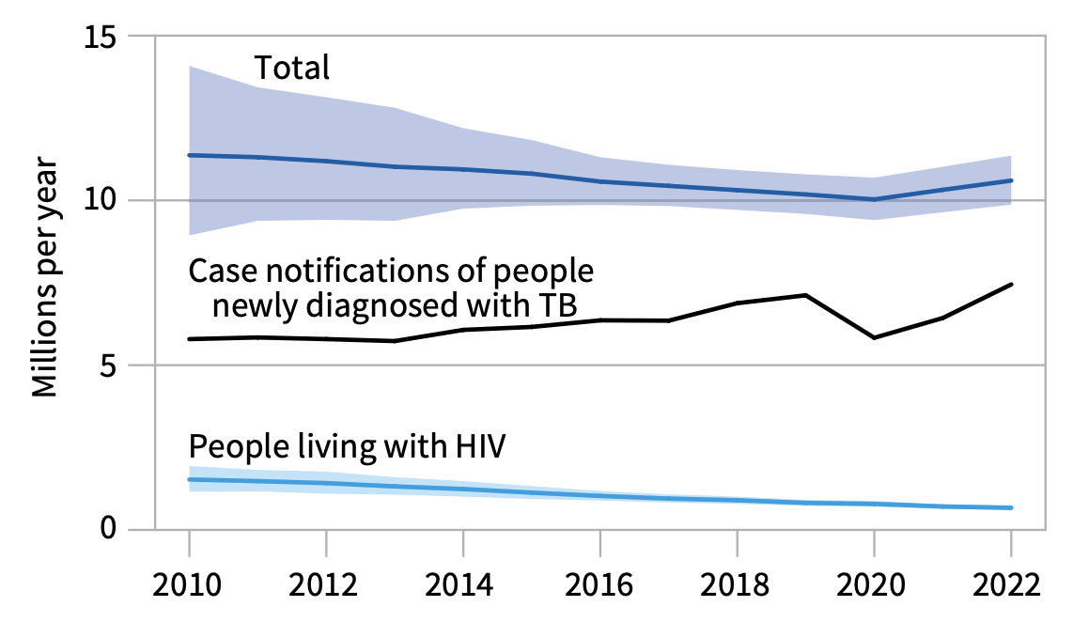
TB treatment is not optimal for most patients
Global trends in the estimated number of incident TB cases
WHO global tuberculosis report 2023
Notes:
So we know that over 10 million people are infected with TB every year
And the standard treatment for these cases of drug-susceptible TB is 6-months of multiple antibiotics

Slide 9
TB treatment is not optimal for most patients
Global trends in the estimated number of incident TB cases
80-85% cure
Month 1-2
Month 3-6
H: Isoniazid
R: Rifampicin
Z: Pyrazinamide
E: Ethambutol
H: Isoniazid
R: Rifampicin
WHO global tuberculosis report 2023
Notes:
Patients are started with 2 months of a combination of 4 antibiotics, which is the HRZE treatment, then 4 months of 2 antibiotics.
This 6-month length was kind of arbitrarily chosen, it works fine for curing most people, but it is not ideal
So most people (80-85%) are actually cured of TB within 4 months of treatment
Meaning that most people are being overtreated for TB.
And these drugs can have pretty serious side effects, most cause liver damage and they can be toxic to different parts of the body.
But this 6-months of treatment is standard because it minimizes the number of patients who are going to relapse, which is when the same bacterial strain re-emerges after the end of treatment

Slide 10
TB treatment is not optimal for most patients
Global trends in the estimated number of incident TB cases
80-85% cure
Month 1-2
Month 3-6
5% relapse
H: Isoniazid
R: Rifampicin
Z: Pyrazinamide
E: Ethambutol
H: Isoniazid
R: Rifampicin
WHO global tuberculosis report 2023
Notes:
BUT even with 6-months of treatment, 5% of people STILL relapse, so 6-months isn’t even long enough to cure everyone
So we have this problem that most patients are overtreated, and are taking unnecessary antibiotics, while others are undertreated, leading to relapse.
But people are having a hard time coming up with better treatment strategies because we don’t know who is going to relapse
If we could identify who needs that longer treatment to prevent relapse, we could create better TB treatment plans

Slide 11
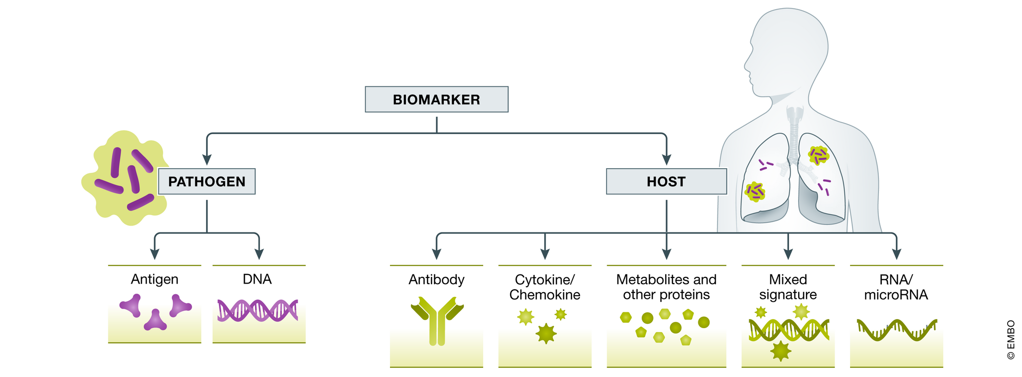
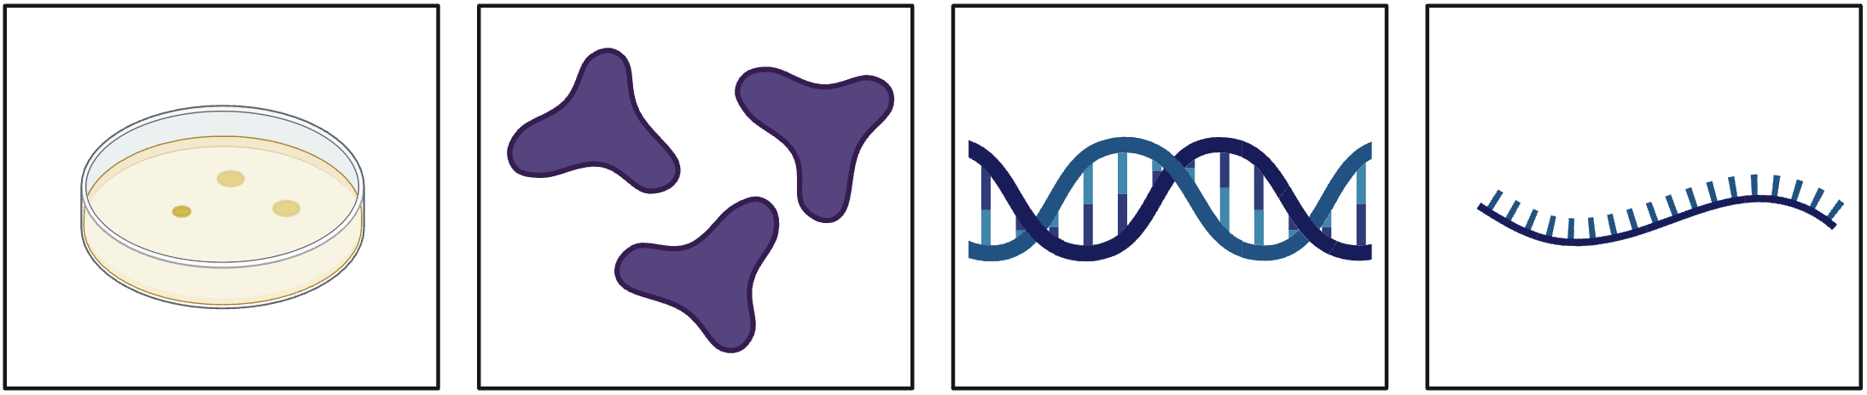
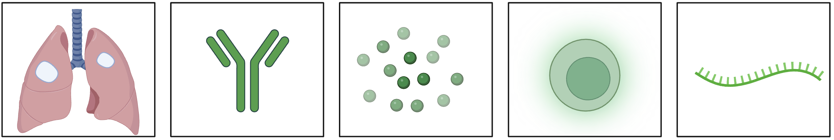
Biomarkers used to predict relapse
Culture
Antigens
DNA
RNA
Cavitation
Antibodies
Cytokines
T-cells
RNA
Modified from Nogueira et al. 2022
Notes:
There has been a lot of interest in finding a biomarker to monitor treatment efficacy and predict outcome both from the bacterial side and the host side
The most used biomarkers right now are culture conversion on the pathogen side, and lung cavitation on the host side.
But they have not been that successful in reliably predicting relapse
For example, trials have shown that people can become culture negative early on in therapy, then still relapse, and patients that continue to show active TB lesions can still progress to cure
BUT there is evidence that bacterial activity could be a potentially useful but so far underexamined indicator of relapse.
(measured by looking at the bacterial RNA)

Slide 12
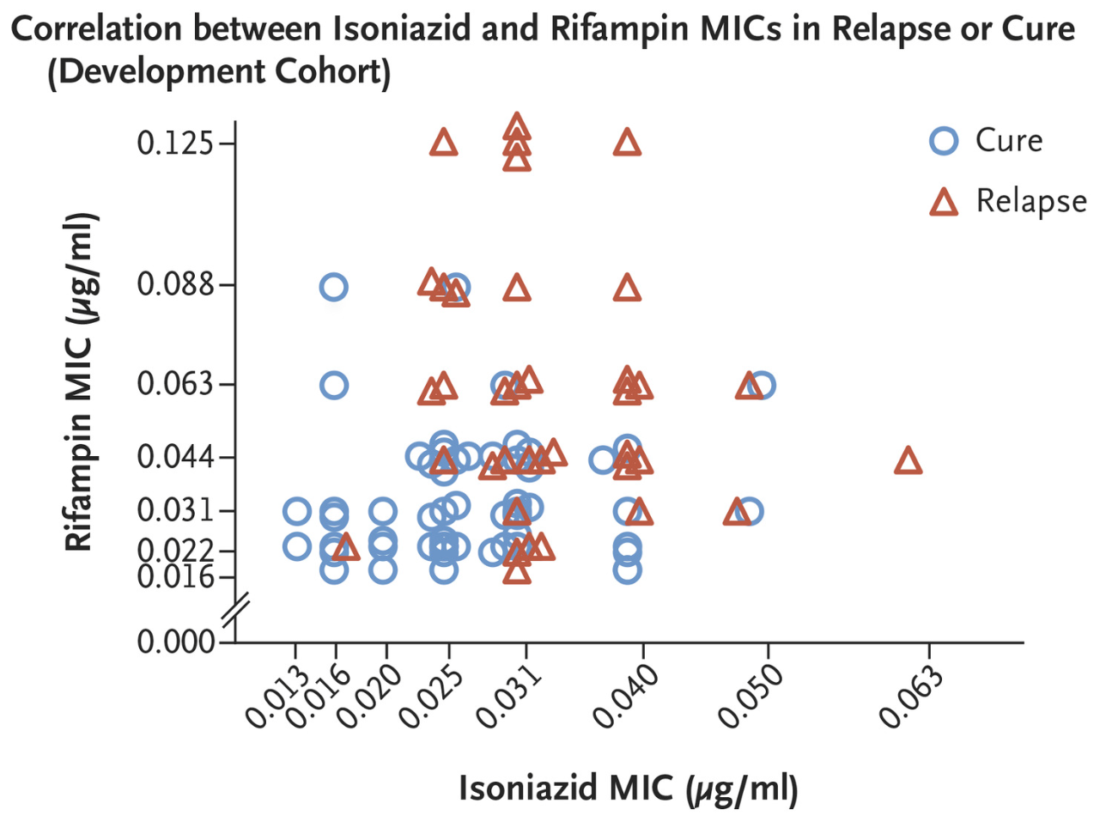
Subtle changes in bacterial phenotype relate to outcome
Colangeli et al. 2018
Notes:
There is some preliminary evidence that subtle changes in bacterial phenotype relate to clinical outcome
This is a graph looking at clinical isolates from patients who either were cured or relapse. I’m sure at lot of people in the audience have seen this graph before so I won’t spend much time on it.
It’s showing the MIC of clinical isolates to two antibiotics isoniazid and rifampin
And all these isolates have slightly different MICs to these two drugs, with cases that go on to relapse (which are the red triangles), having a trend of higher MICs compared to cases that go on to cure (which are the blue circles).
And this study showed that when the MIC is included in a predictive model, the model becomes more successful at predicting outcome
So this gives us reason to believe that bacterial activity impacts treatment outcome and may be useful in predicting likelihood of relapse
Thinking more about bacterial activity during treatment….
### So what are these relapsing bacteria actually doing in the lung?
## All of these MICs are still below the drug resistance threshold, so they are all still classified as drug-susceptible strains

Slide 13
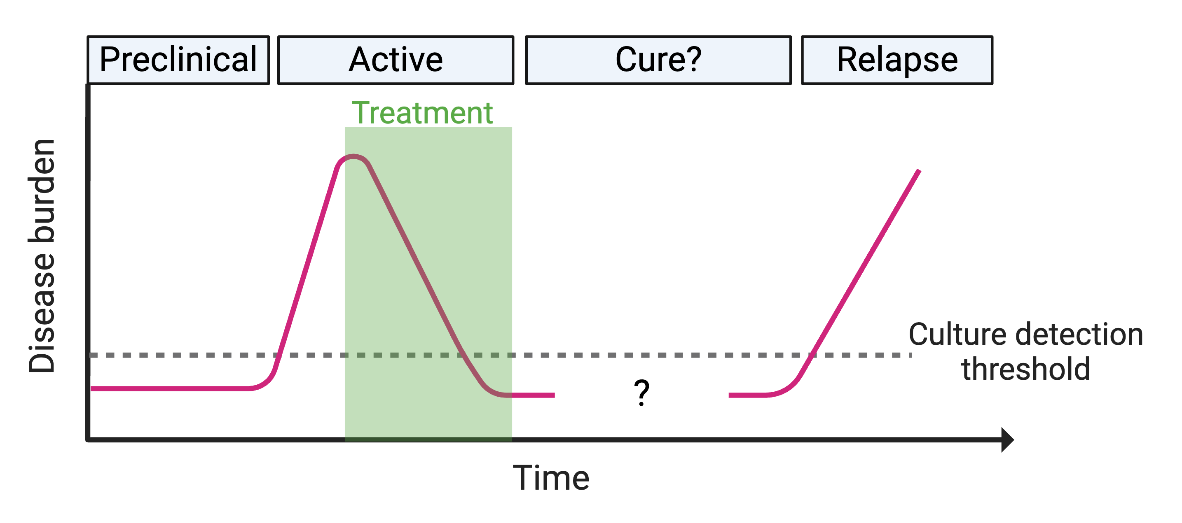
Mtb surviving in the lung rebound after TB treatment
Notes:
This graph is showing the stages of TB disease over time in cases that lead to relapse. (in a very stylized manner)
A person gets infection and there is this period of latent pre-clinical infection,
At some point a person can develop symptoms, and become culture positive for TB, and they start getting treated with that 6-month regimen.
By the end of the 6 months they are no longer culture positive for TB, and it seems like the treatment worked.
BUT in this subset of people, there are viable bacteria still present, below this culture detection threshold, and after drug pressure is removed, they result in relapse.
**And people have actually been able to amplify Mtb RNA from patients sputum throughout this 6 months of treatment, even after the person is below this culture detection threshold, so we know there are live TB still producing RNA even when the bacteria are undetectable by culture methods.
But! We don't know much about what these bacteria that survive drug treatment are doing.
So we want to look into these bacteria that are surviving drug treatment
And we are going to do this by examining bacterial RNA signatures from clinical sputum samples.
(See what they're doing and see if their actions could be predictive of relapse)

Slide 14
PredictTB Phase II clinical trial
Start HRZE
Start HR
Complete HR
Arm A
154 cures
7 relapses
W2
W4
W8
W16
W24
W48
W72
Enrollment
(W0)
Complete HR
Arm B
79 cures
2 relapses
Start HRZE
Start HR
W16
W24
W48
W72
Randomization of eligible participants
W2
W4
W8
W16
Complete HR
66 cures
12 relapses
Eligibility for shorter therapy:
Low PET/CT activity at W0
>20% decrease in cavity size at W4
GeneXpert Ct ≥28 at W16
Arm C
(Early completion)
W16
W24
W48
W72
Notes:
So we are very fortunate to have access to sputum samples collected as part of the PredictTB Phase II clinical trial from South Africa (that is led by Cliff Barry at the NIH)
In this trial, They attempted to use lung pathology (from PET/CT scans) combined with presence of Mtb DNA in sputum (from the GeneXpert cycle threshold) to identify patients that could complete a shorter 4 month treatment without an increased likelihood of relapse
People who didn’t meet these criteria were moved to Arm A and completed the standard 6-month antibiotic therapy
People who did meet the criteria were randomized at week 16 to either receive the standard 6-month therapy or complete therapy early after only 4 months of treatment.
Unfortunately, this trial was not able to successfully stratify participants. While Arm B, which was the control arm had 2 relapse cases, Arm C with 4 months of treatment had 12 relapses.
** And I think this really highlights this issue we have of standard biomarkers (in this case lung pathology and presence of bacterial DNA) not being very successful indicators of treatment outcome. **
Another thing that they collected throughout this trial were sputum samples. And at each of the weeks shown on this diagram, they collect sputum in the clinic and immediately put them in TRIzol to preserve the bacterial RNA.
And they recently sent us sputum samples from all of these timepoints, which we can use to examine the transcriptional profile of Mtb.
And most importantly we can attempt to tie transcriptional changes to treatment outcome
So we've got two major questions we are trying to answer...

Slide 15
PredictTB Phase II clinical trial
Start HRZE
Start HR
Complete HR
Arm A
154 cures
7 relapses
W2
W4
W8
W16
W24
W48
W72
What is the transcriptional activity of Mtb in vivo?
How do relapse strains differ from cure strains?
Enrollment
(W0)
Complete HR
Arm B
79 cures
2 relapses
Start HRZE
Start HR
W16
W24
W48
W72
Randomization of eligible participants
W2
W4
W8
W16
Complete HR
66 cures
12 relapses
Eligibility for shorter therapy:
Low PET/CT activity at W0
>20% decrease in cavity size at W4
GeneXpert Ct ≥28 at W16
Arm C
(Early completion)
W16
W24
W48
W72
Notes:
First: What is the transcriptionally activity of Mtb in vivo?
this is getting at what is the underlying biology of these bacteria that are surviving in the human lung (both before and during drug treatment)
And second is how do relapse strains differ from cure strains? Are there any distinguishing transcriptional characteristics between these two groups that could be used as biomarkers to predict treatment outcome?

Slide 16
Mtb transcriptional activity over the course of therapy is unclear
Notes:
Very little is currently known about the transcriptional activity of Mtb in the human lung.
There have been a few papers published looking at the gene expression of Mtb from sputum samples but they’ve been quite limited in what they can determine…

Slide 17
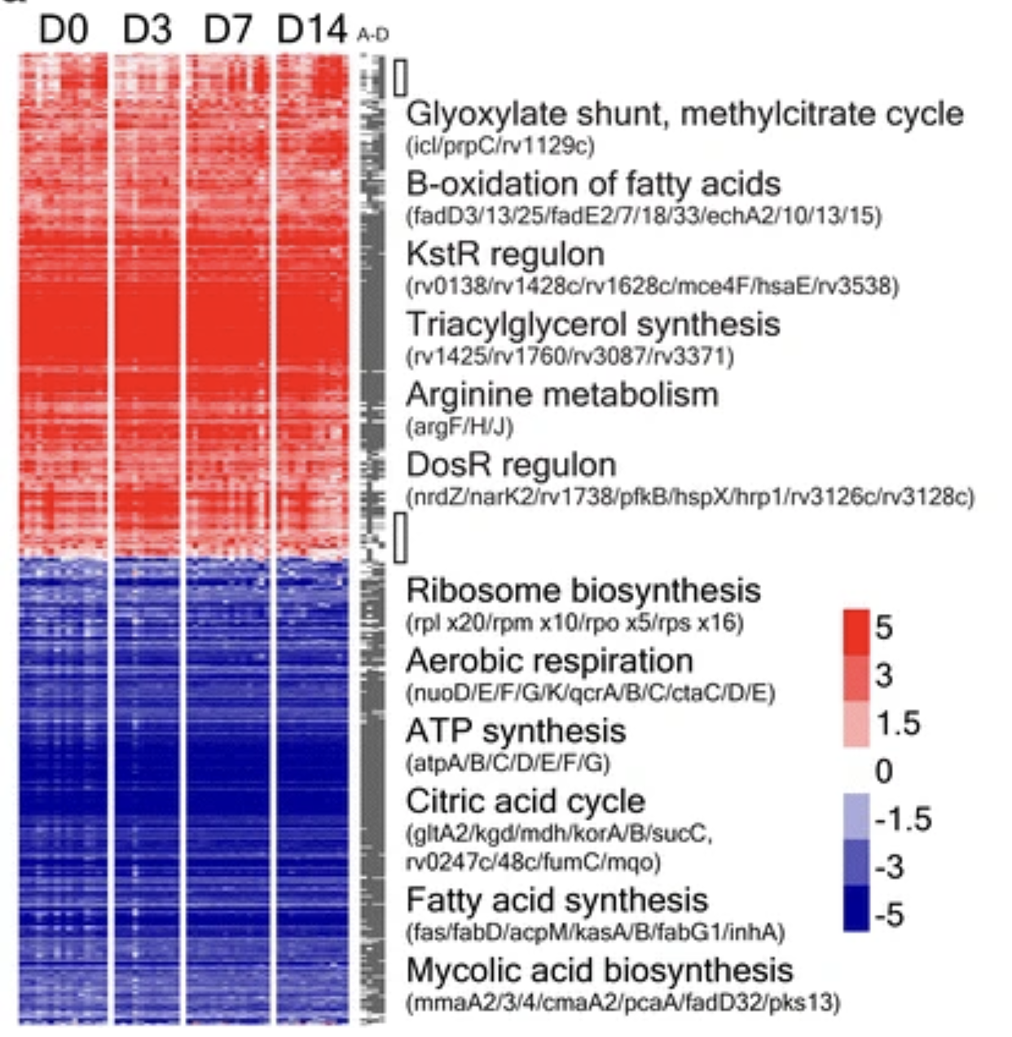
Mtb transcriptional activity over the course of therapy is unclear
Honeyborne et al. 2016
Notes:
These are results from one of those studies
They collected sputum samples from patients at day 0 before the start of treatment, then up to 2 weeks after treatment start and measured gene expression with microarrays then compared it to broth culture, which is the differential expression they are plotting here.

Slide 18
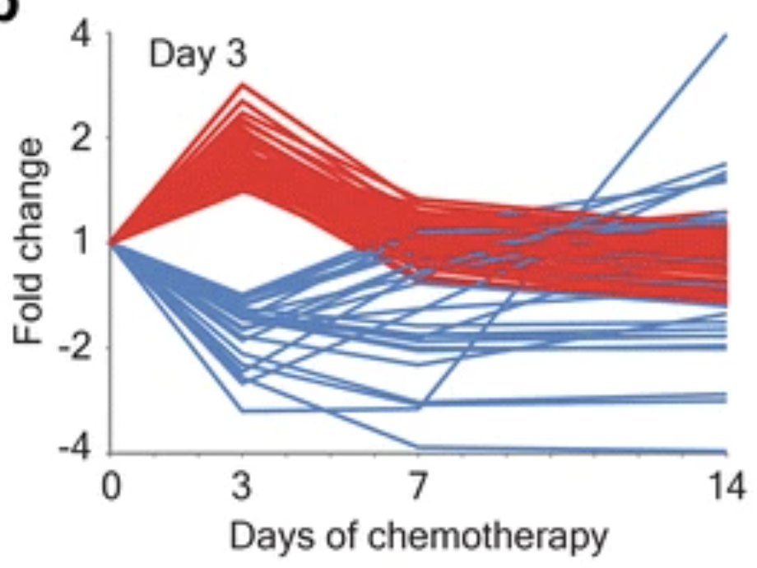
Mtb transcriptional activity over the course of therapy is unclear
Honeyborne et al. 2016
Notes:
And they were also able to look at gene expression patterns over time up to day 14
But this study and others like it have been limited in how much they can discover from clinical sputum samples.

Slide 19
Mtb transcriptional activity over the course of therapy is unclear
?
Current limitation to in vivo studies
Small sample sizes
Unknown treatment outcome
Minimal Mtb mRNA in sputum samples
Honeyborne et al. 2016
Notes:
Most studies have very small sample sizes, this one only looked at 15 patients
Most do not have information on whether the person progresses to cure or relapse so cannot examine how bacterial activity impacts treatment outcome.
And then finally the amount of bacterial mRNA decreases substantially after the first few days of treatment, which is likely why this study and others like it it can only define the transcriptome up to 14 days, we don't really have any idea of what happens after this point
But!
Using samples from the PredictTB trial gives us a large sample size and known treatment outcome,
And then to deal with this problem of a small amount of Mtb mRNA, we need some way to enrich for this tiny amount of Mtb mRNA
## we’re going to use a hybridization and enrichment sequencing approach called transcript capture sequencing

Slide 20
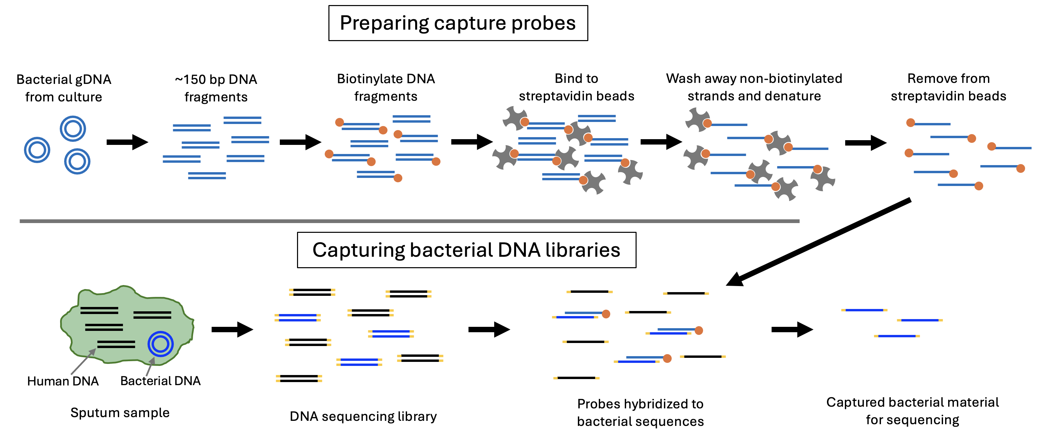
Genome Capture Sequencing
Modified from Hayden et al. 2022
Notes:
And to do that we started with this protocol from the Singh lab at the University of Washington called genome capture sequencing.
Which has been used to enrich for pseudomonas DNA in cystic fibrosis patient sputum samples.
And the way it works is you go through these steps to generate single stranded biointylated probes starting from DNA of bacterial cultures. [go through steps]
These probes that are specific to that bacterial genome can then be hybridized to a sequencing library made from the total DNA of a sputum sample.
The probes will just bind to the bacterial genome, you can wash away any DNA that doesn’t bind, and you’re left with this final library enriched for bacterial DNA. Which you can then go on and sequence.
So we wanted to make these probes starting with a Mtb culture to make the probes, and hybridize the probes to RNA libraries.
Unfortunately when we started trying to use this protocol on Mtb RNA libraries, it was pretty inconsistent in how well it worked.
And something that I found concerning was no one had been able to quantify the concentration of these biotinylated probes, so we had no idea how much probe was made during this prep, or how much probe was added to the sequencing library.
So I’ve spent the last few months troubleshooting this protocol with the goal of being able to measure the probe concentration at the end of the protocol and getting it to successfully work on Mtb RNA.
#########
And we were trying to figure out why….
And when I started trying to troubleshoot this protocol the first thing that I found very concerning was that no one had been able to quantify how much single stranded biotinylate probe this was in this top sample. The qubit always said the concentration of the sample was too low to quantify, and even nanodrop (which in my experience always seems willing to say there is lots of material in a sample), wasn’t giving a reading.
The lab that made this protocol just assumed that there was something about single stranded biotinylated DNA that made it recalcitrant to being measured, and since it was working for them they weren’t too worried about it.
But it didn’t make any sense to me why this material couldn’t be measured, I thought it was more likely that there wasn’t enough material to measure. And not having enough probe for this capture reaction is what is causing it to give pretty inconsistent results.

Slide 21
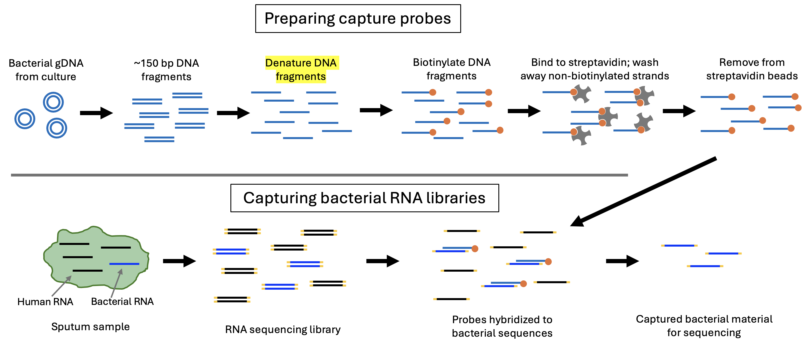
Transcript Capture Sequencing (TC-Seq)
Notes:
So now we have transcript capture sequencing (or TC-seq)
And I found out that the reason we couldn’t quantify the final probe is because there was too little material there to be quantified. And I think the reason we were getting inconsistent results before is there just wasn’t enough probe in some of the samples to work.
I modified a lot of steps in here to help us retain the probe DNA, and I’m not going to go into all the details,
But one of the main changes was denaturing the DNA before biotinylation. This really increased the efficiency of biotinylation which helped me retain enough measurable probe material at the end of this protocol
Which is really helping to optimize how much probe is needed for a successful capture

Slide 22
TC-Seq amplifies Mtb mRNA from mixed samples
Show for proof of replication?
Could remove shape and just have two non-probed outgroups
Notes:
These are just come testing samples we used to check if the capture it working, they are THP1 cells that have been spiked with H37Ra.
And these samples are all technical replicates that have been sequenced using this capture method with different probe preps, and they all cluster well together, showing that this sequencing method is robust. So as long as we are using enough probe, probes prepped differently will still amplify out the same thing……..

Slide 23
TC-Seq amplifies Mtb mRNA from mixed samples
Which graph is better?
Notes:
And this is hot off the sequencer, but we just did a run using these new probes and showed that they successfully enriched for mycobacterium mRNA out of several different sample types.
And we included just a few sputum samples from the PredictTB trial.
And we were successfully able to enrich for the Mtb RNA out of these samples.
We sequenced two samples from before the start of drug treatment (week 0), 2 samples from week 2, and 2 samples from week 4.
The week 0 samples look the best, with over 1 million reads aligning to Mtb, and this decreases as antibiotic treatment progresses
The week 4 samples are not so good, with just about 60,000 to 130,000 reads aligning. But this is still an enrichment because if we just sequenced without the transcript capture, we would only get maybe a couple hundred reads aligning
So we’re pretty happy about this and I’ve got some more ideas about how to increase this number even more which I’m hoping to implement soon.

Slide 24
TC-Seq amplifies Mtb mRNA from mixed samples
Show a PCA?

Slide 25
TC-Seq amplifies Mtb mRNA from mixed samples
Volcano plot?

Slide 26
TC-Seq amplifies Mtb mRNA from mixed samples
Show marmosets?
Notes:
And as another little teaser, I ran some marmoset samples from a study done by ___ and the NIH?? Which the Sherman lab is also planning on doing TC seq on, and they look even better than the sputum samples, with even more reads aligning to Mtb. So that’s great

Slide 27
Conclusions
Bacterial activity (RNA signatures) is a potential marker for TB treatment outcome
Sputum samples from the Predict TB trial can help address the questions:
What is the transcriptional activity of Mtb in vivo?
How do relapse strains differ from cure strains?
Transcript Capture Sequencing (TC-Seq) successfully enriches for Mtb mRNA in sputum (and marmoset samples?)

Slide 28
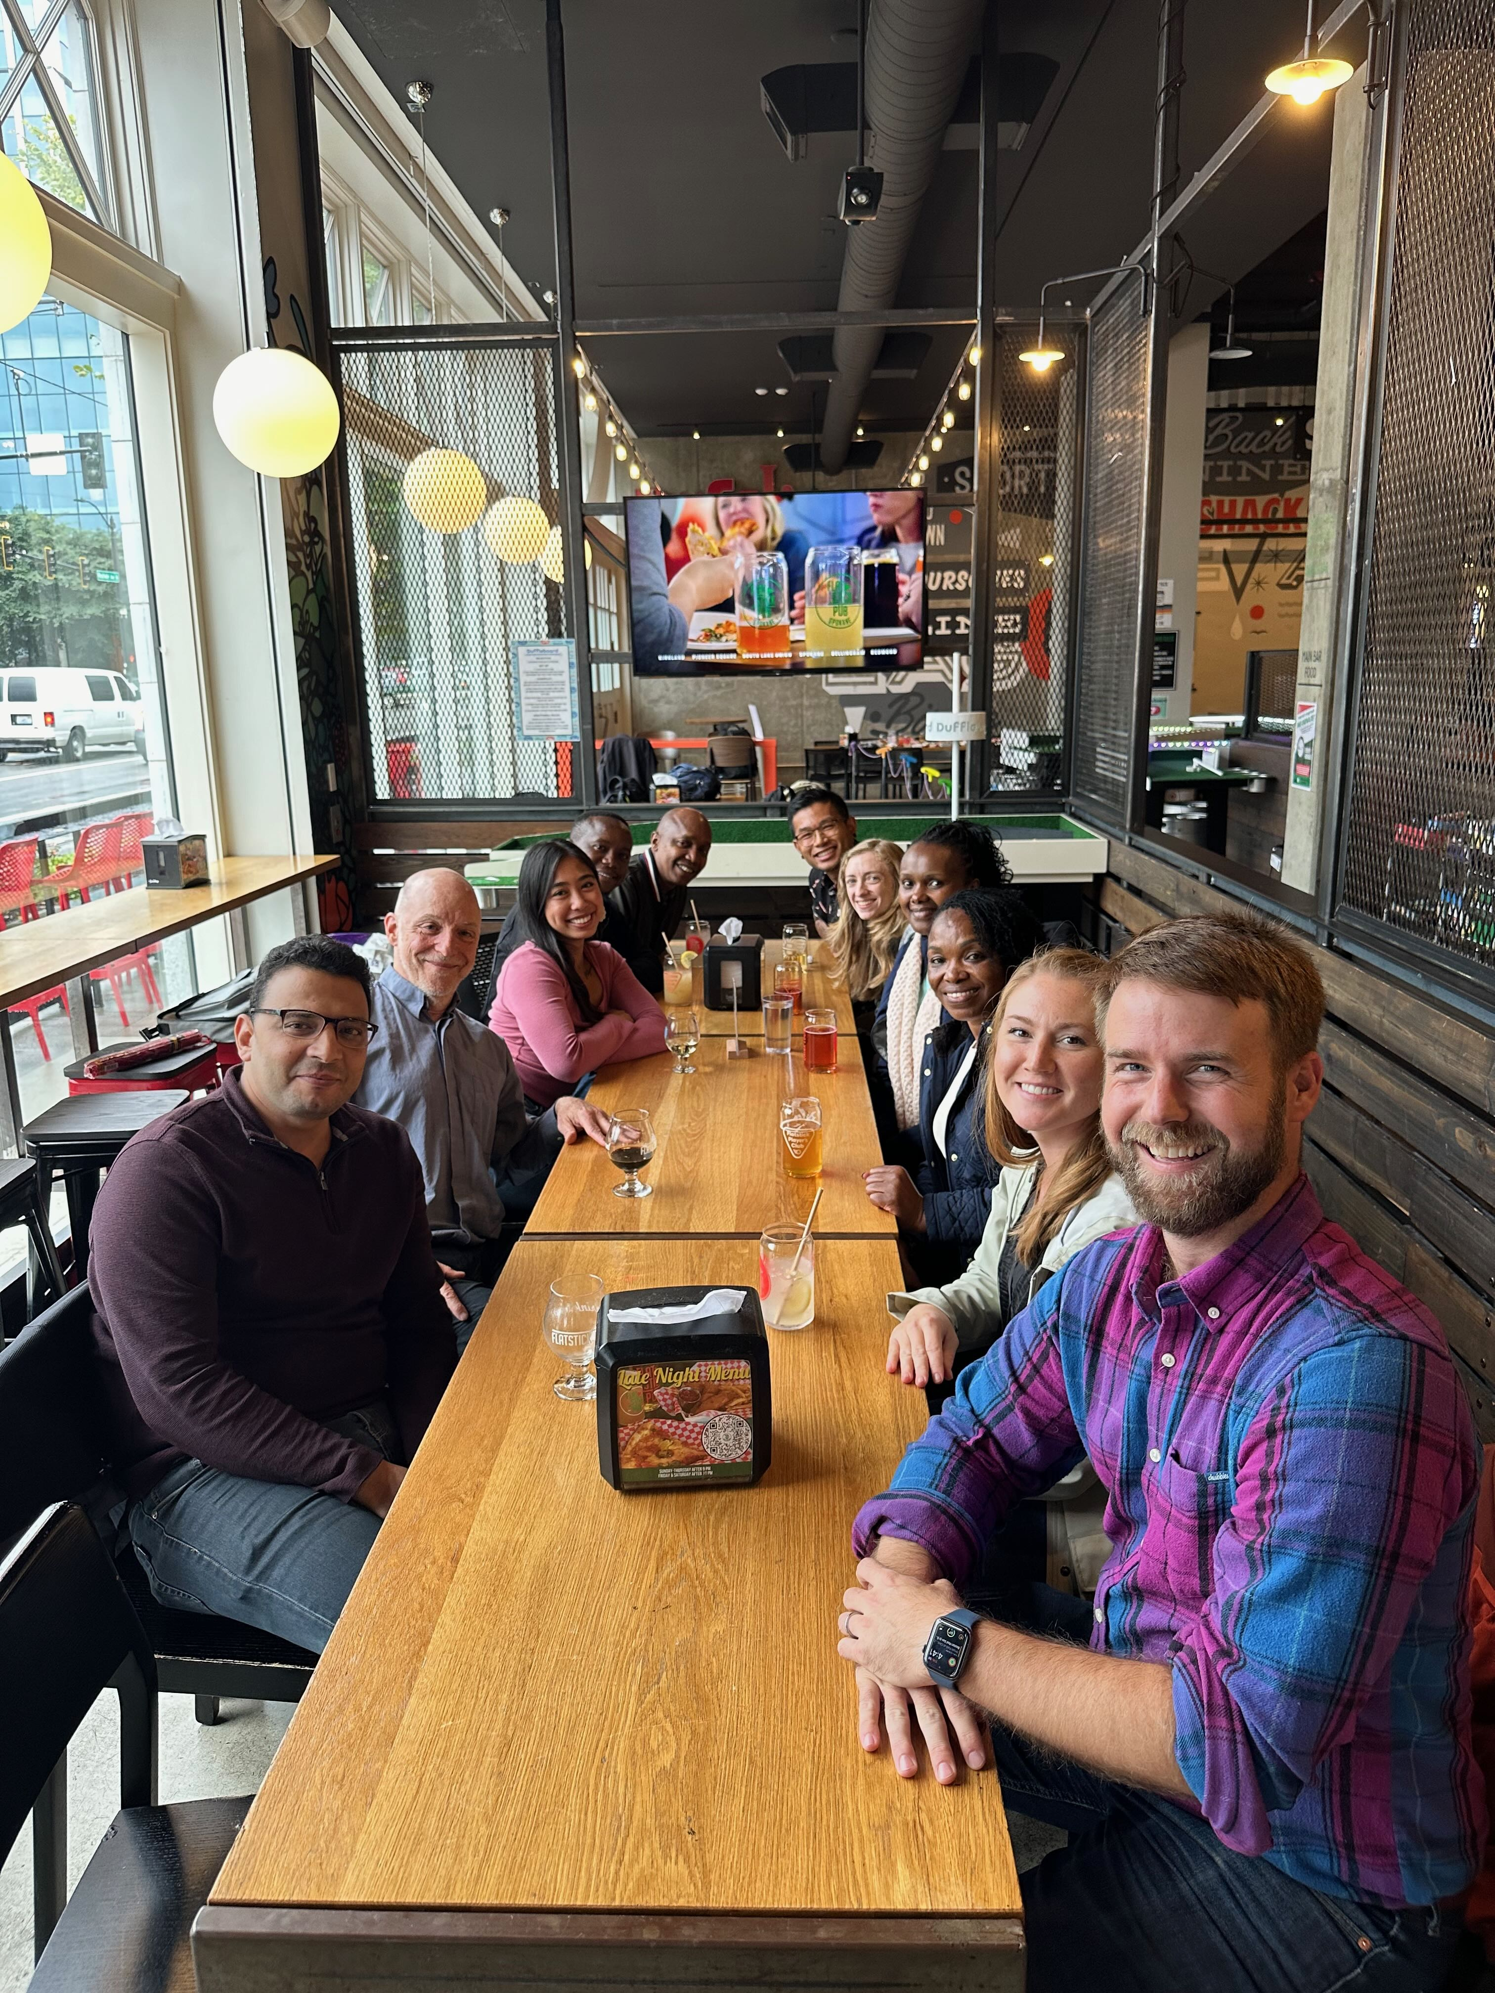
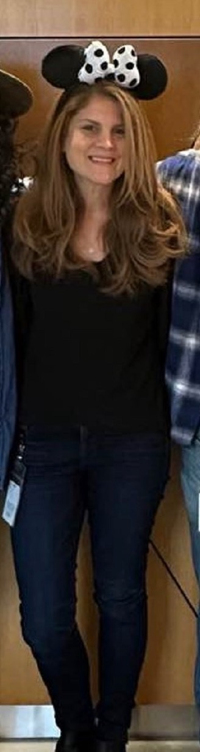
Thank you!
Sherman Lab
David Sherman
Mark Jones
Jessica Assadi
Kristin Adams
Hassan Eldesouky
Laarni Aguila
Lance Fredericks
Jose Manuel Ezquerra Aznarez
Justin Brache
Annie Squires
Bob Morrison
PredictTB
Shawn Yu
Taeksun Song
Barry Clifton
Robert Wilkinson
Laura Via
Thesis Committee
Shuyi Ma
Chetan Seshadri
Matt Parsek
Josh Woodward
Alison Fohner
Notes:
- Especially Mark Jones who started doing all the transcript capture seq work in the lab.

